Slide 1

Predicting Parkinson’s
Cindy Mateus, Tianxiao Cao, Reianna Liu, Alec Druggan
Notes:
Introduction

Slide 2

Project Scope
The goal of this project is to be able to use voice recordings to both classify the status of and, if they were to have the disease, monitor progress of Parkinson’s Disease by predicting motor function values.

Slide 3
Technologies Used
Github Projects
SQLite
Pandas
NumPy
MatPlotLib
Seaborn
Tableau
SciKit-Learn/sklearn
Tensorflow
Keras_Tuner
IterTools
ParselMouth
SciPy
Librosa

Slide 4
Data Sourcing
Two data sources/sets were used in creating this project.
The first dataset is a set of voice measurements from 31 people. Twenty-three of those whose measurements are present have been diagnosed with Parkinson’s Disease. There are 195 recordings from these individuals in the dataset.
The second dataset is a set of 16 voice measurements from 42 people with early-stage Parkinson’s disease. They were recruited into a six-month trial where there voice measurements were taken around 200 times per patient. There are a total of 5,875 recordings in this dataset.

Slide 5
Data Set/Source citations:
'Exploiting Nonlinear Recurrence and Fractal Scaling Properties for Voice Disorder Detection', Little MA, McSharry PE, Roberts SJ, Costello DAE, Moroz IM. BioMedical Engineering OnLine 2007, 6:23 (26 June 2007) IEEE Transactions on Biomedical Engineering (to appear).
Athanasios Tsanas, Max A. Little, Patrick E. McSharry, Lorraine O. Ramig (2009), 'Accurate telemonitoring of Parkinson’s disease progression by non-invasive speech tests', IEEE Transactions on Biomedical Engineering (to appear).

Slide 6
Data Processing
Once we have extracted the files from the source, we then make use of SQLite to construct a database which we then extract the data and create data frames from.
We create tables with both of our separate datasets, as they store different values and data points.

Slide 7
Relevant Column Information for Voice Measurements:
Fo, Fhi, Flo: Measures of average, maximum, and minimum fundamental frequency in hz
Jitter (%, Abs, DDP), RAP, PPQ: Measures which describe cycle-to-cycle variations in the timing or frequency of the voice signal
Shimmer (dB, APQ3, APQ5, APQ, DDA): Measures which describe cycle-to-cycle variations in the amplitude
NHR, HNR: Noise to Harmonics and Harmonics to Noise Ratios
RDPE (Recurrence Period Density Entropy): Measures unpredictability or irregularity of a time series
DFA (Detrended Fluctuation Analysis): A measure of self similarity in a time series.
PPE (Pitch Period Entropy): A measure of the degree of randomness or irregularity in the pitch period of a voice signal

Slide 8
Prediction Model Creation

Slide 9
Values For Model to Predict
For the prediction model we created we used the of 16 voice measurements from 42 people with early-stage Parkinson’s disease, which contained 5,875 recordings as well as calculated the total and motor values for the Unified Parkinson's Disease Rating Scale (UPDRS), which is what we would be predicting.

Slide 10
Approaches to Modeling
Linear Regression
Support Vector Regression
Random Forest
Gradient Boosting
Neural Network

Slide 11
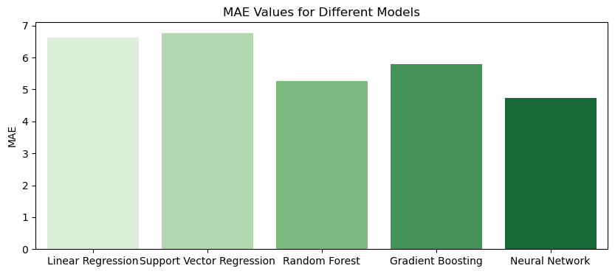
Mean Absolute Error Visualization, Per Model

Slide 12
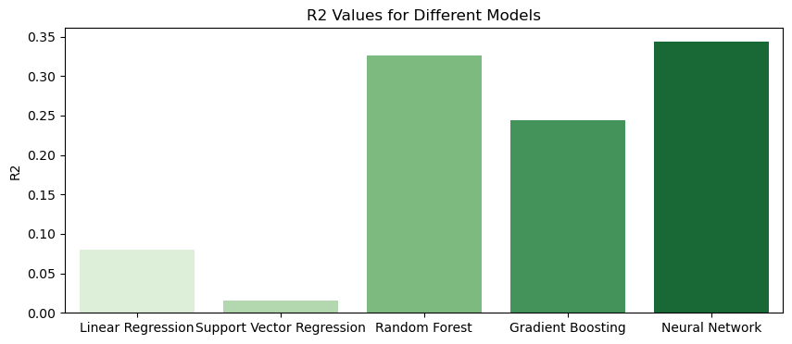
R² Visualization, Per Model

Slide 13
Considerations
We attempted multiple different methods of modeling and predicting the UPDRS scores, alternating between targeting the Total and Motor scores. We were unable to find a model that could accurately predict with the given data, so we moved to classifying Parkinson’s status rather than predicting UPDRS with a given recording.

Slide 14
Classification Model Creation

Slide 15
Approaches to Modeling
We created several different models to see which would best allow us to create status classifications with the dataset. Those models were the following:
Linear Regression Model
Random Forest Classifier
Support Vector Machine
Neural Network
Next, we compared the predictions the model created based on the data, and then calculated the accuracy of each model. Then we compared the confusion matrices and accuracy scores for the models to select one to move forward with.

Slide 16
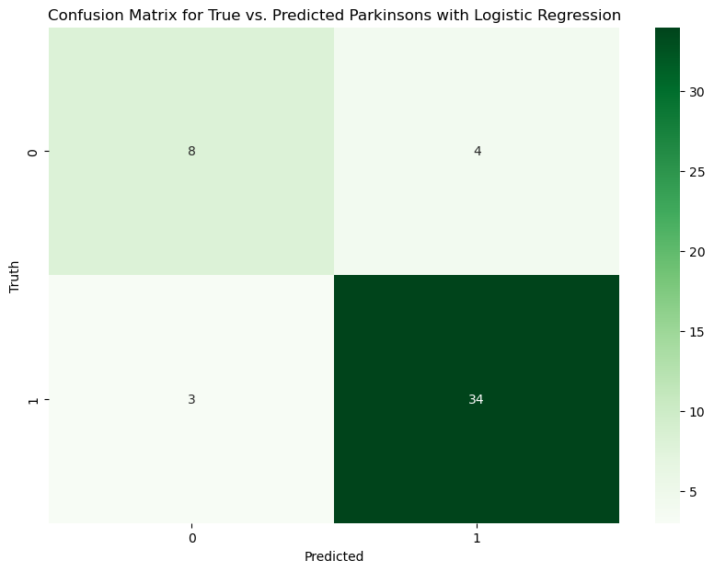
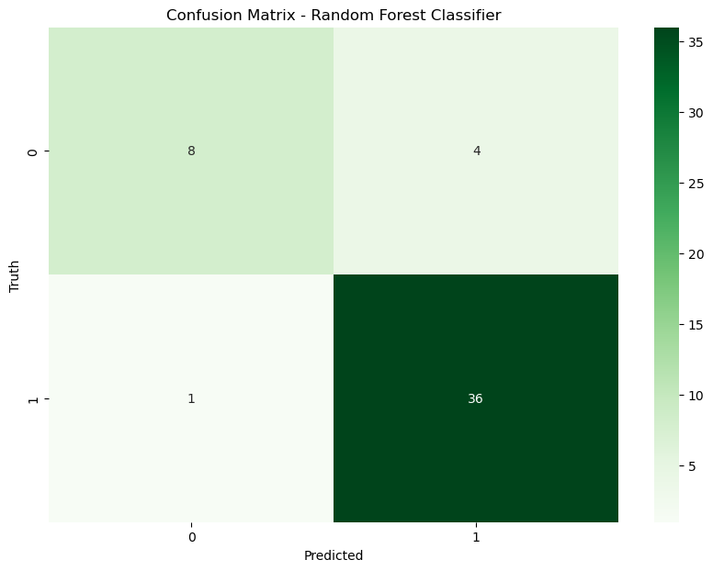

Slide 17
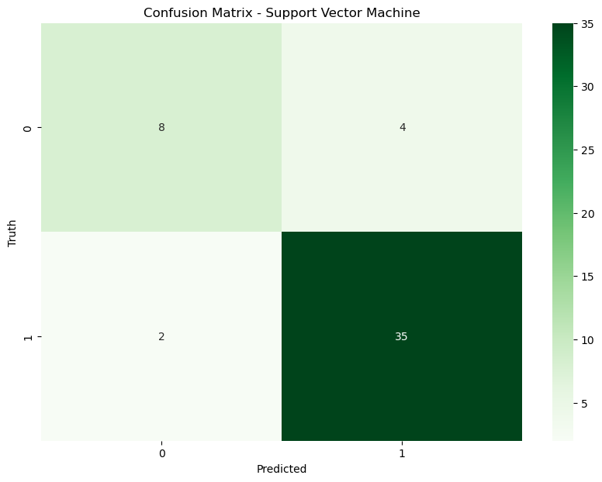
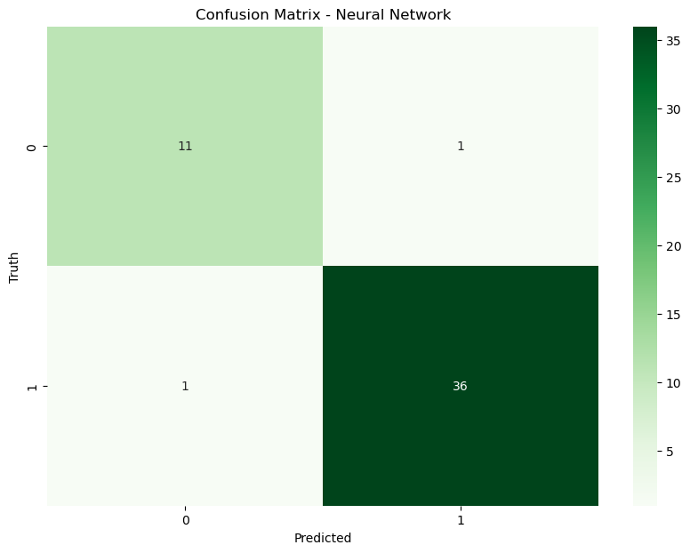

Slide 18
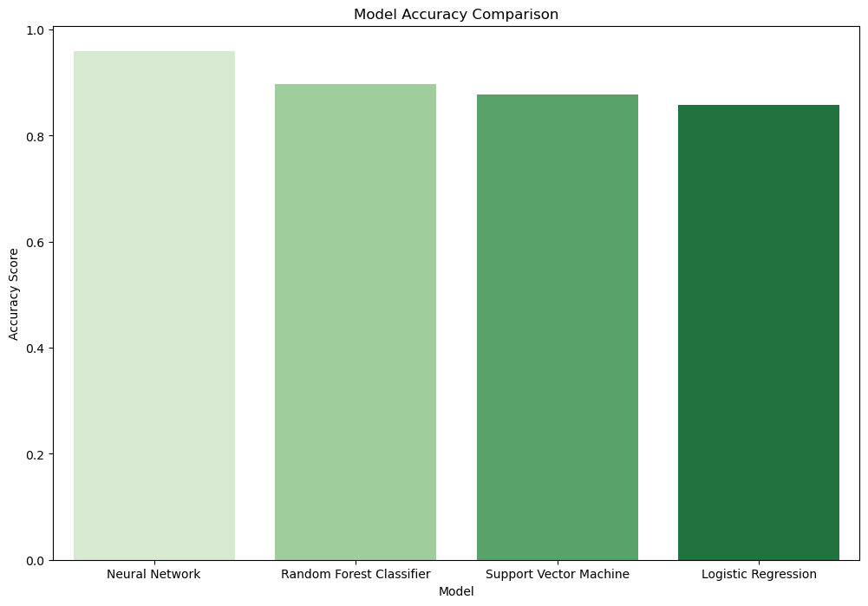

Slide 19
Other Comparisons Before Model Selection
In addition to comparing the above metrics, we also compared the classification reports for the different models. After taking these different model measurements into consideration we decided to proceed with a neural network.

Slide 20
Optimizations:
In order to optimize our neural network we made use of the Keras Tuner python library, constructing a hyperband parameter tuner to facilitate the best parameters for our model.
Optimizations regarding tuning are detailed in the following slides. Additionally, dense layers where all nodes were connected to preceding layers were found to provide highest accuracy.
Here is the final classification report for the model:

Slide 21
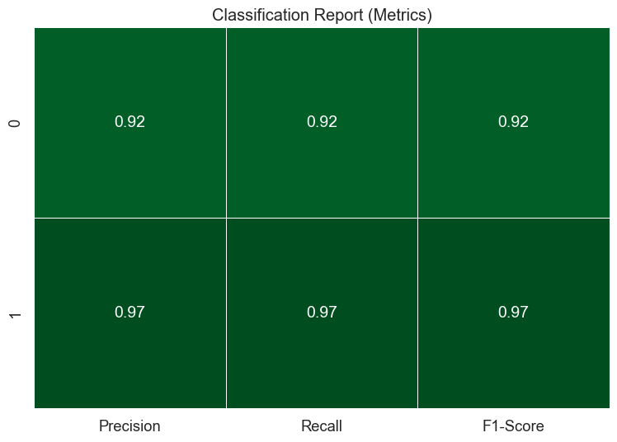
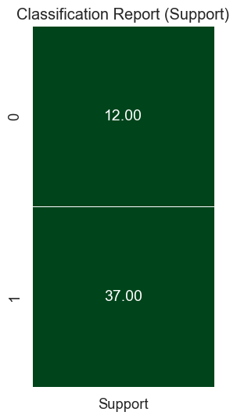

Slide 22
Optimized Sequential Model Parameters
Layer
First Layer
Hidden Layer 1
Hidden Layer 2
Hidden Layer 3
Output Layer
73 Nodes
57 Nodes
63 Nodes
37 Nodes
1 Node
Dimensions
Activation Function
tanh
ReLU
ReLU
sigmoid
sigmoid 0.01 Learning Rate

Slide 23
Final Results of Classification Model
While we were unable to create a model that could predict the value of Motor UPDRS with R² ≥ 0.80, we were able to create a classification model for the status of Parkinson’s disease with a classification accuracy ≥ 75%.
Further, the improvements we made to the model made it so that we reached a classification accuracy of just under 96% (95.92%).

Slide 24
Creating Additional Data

Slide 25
Voice Measurements from Audio Files
While this was outside of the original scope of the project, we wanted to be able to facilitate the creation of a tool for users to submit audio recordings and run them through our models.
To do so, we had to create a notebook which would analyze an audio file and generate the voice measurements in the same way they would have been for the original data set.
While we do not have access to the equipment used by the scientists that created the original dataset, a user of this with access to the correct tools would then be able to use this program to add data to our database.

Slide 26
Setting Up for Metricization
To properly create measurements that are congruent with the data/models created, we automated the process of correct measurement and variable modifiers for the output data.

Slide 27
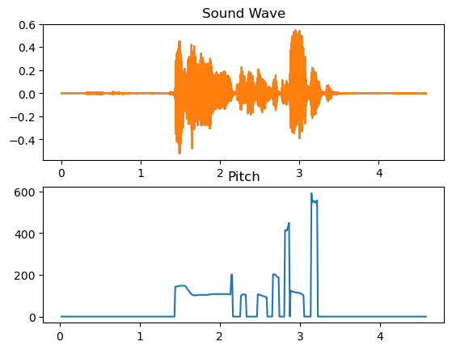
Sample Sound Recording (frq, pitch)

Slide 28
Data Points Generated from Sample Recording
 | Jitter | Shimmer | HNR | NHR | RPDE | DFA | PPE
Values | 0.08272 | 0.08272 | 8.92196 | 8.92196 | 11.7254 | 0.16424 | 1.70769

Slide 29
Next Steps

Slide 30
Scope Expansion
With the recording and data generation set up, we would want to be able to deploy this as a WebApp that could be used by anyone to facilitate the creation of new data points. Initially, we would want to be testing with a mix of users who are both positive and negative for Parkinson’s Disease, but with enough data, testing, and high enough model accuracy we could develop a program to showcase if a user, if otherwise healthy, has the disease, with certainty up to that of our model’s accuracy.

Slide 31
The end

